Slide 1
Smart Parking Solution
With IoT
By Jason Mercury Bo Chi

Slide 2
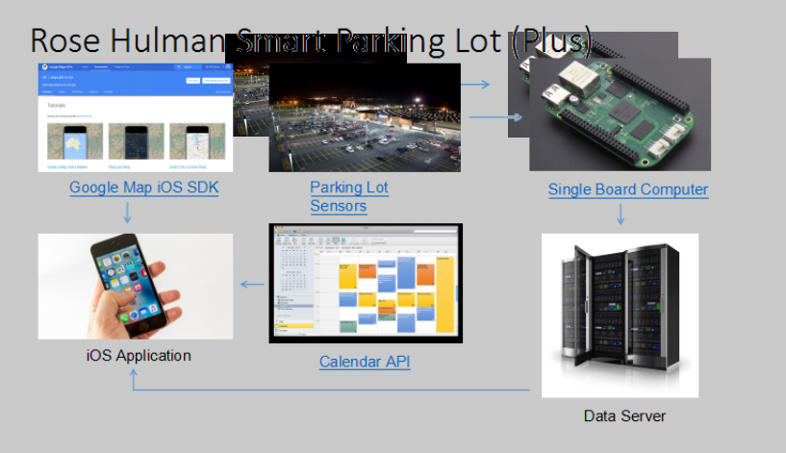
Introduction
Notes:
Chi

Slide 3
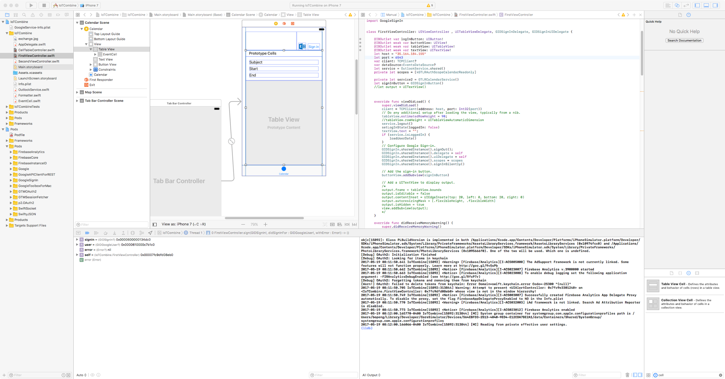

Slide 4
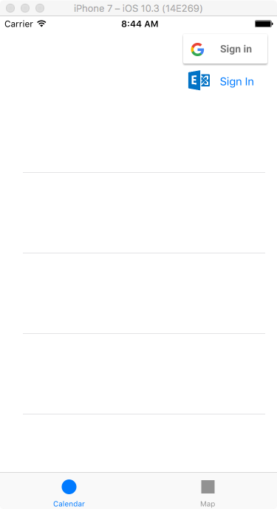
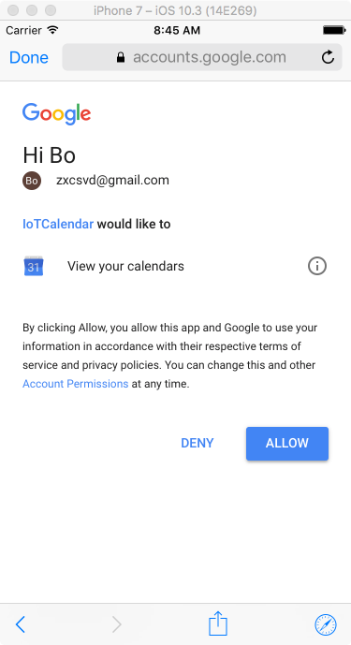
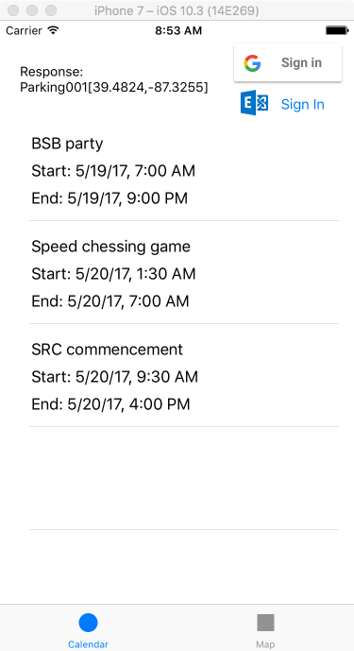

Slide 5
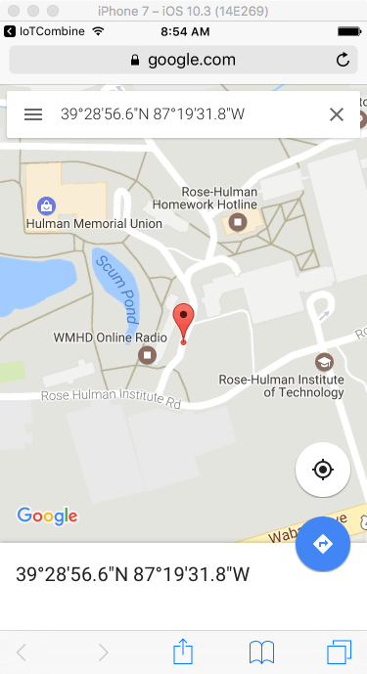
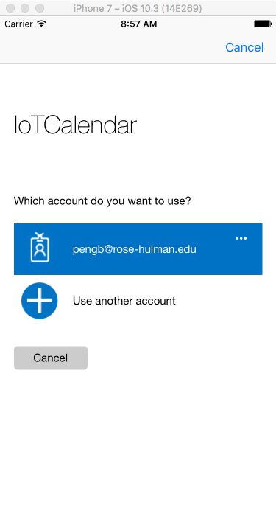
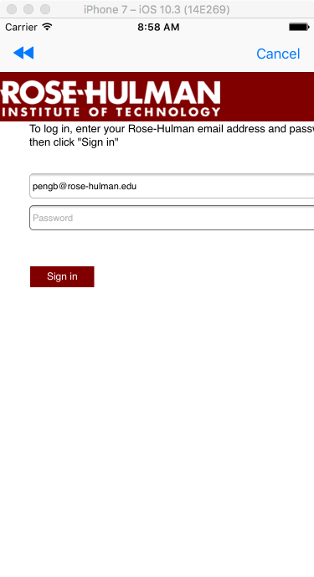

Slide 6
App Architecture
Google Calendar API
Exchange REST API
Socket IO
Google map API

Slide 7
Server
A complete system format for server
Socket
MongoDB
Java
Notes:
jason

Slide 8
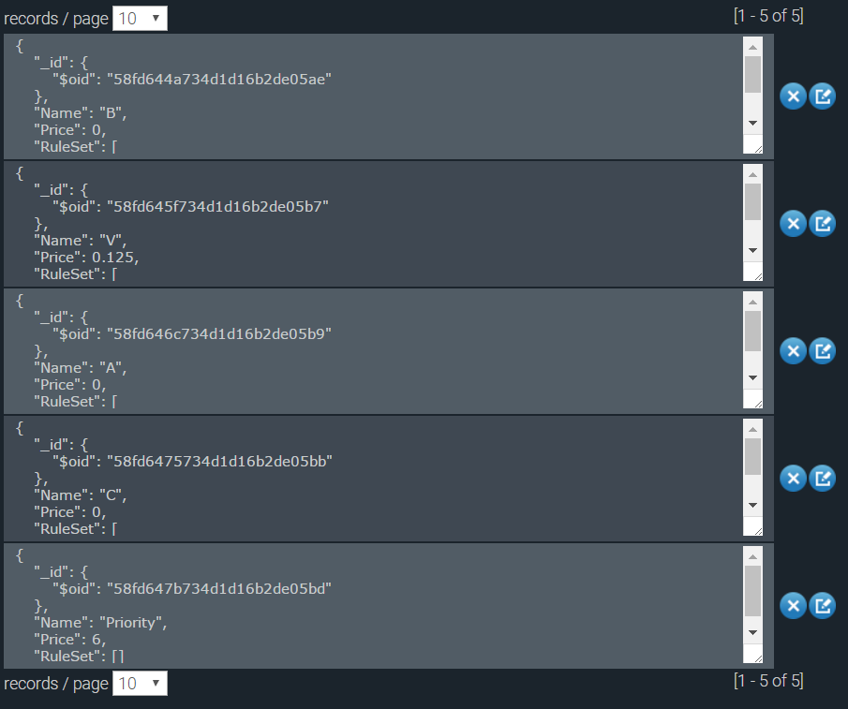
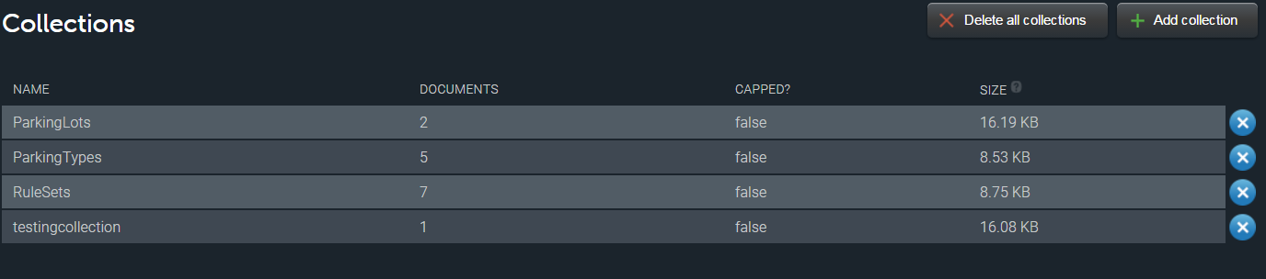
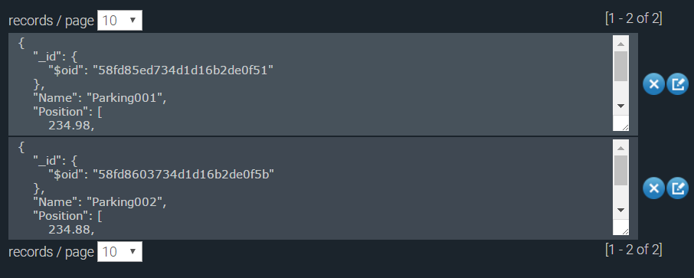
Database
Notes:
jason

Slide 9
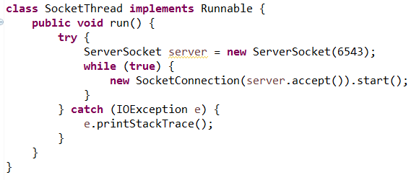
Socket
Notes:
Mercury

Slide 10
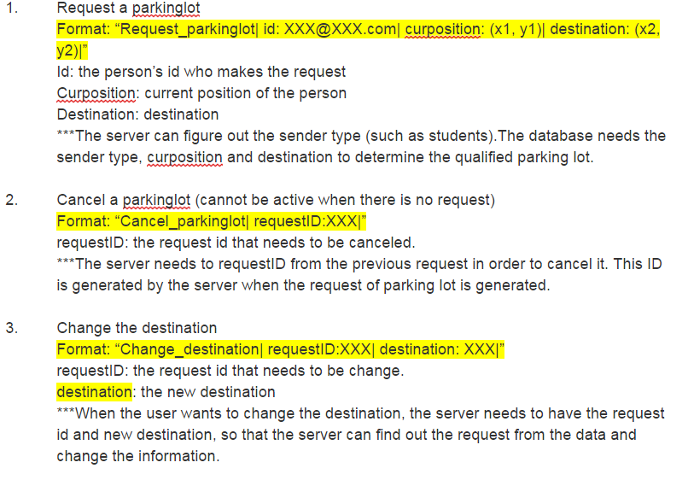
API
Notes:
Mercury

Slide 11
Q&A

Slide 12
Project Demo

